Slide 1

SQL Practice Queries
By Neftali Lemus

Slide 2
Overview
The following SQL queries are based on the online exercises available at https://www.sql-practice.com/, a free website that lets you freely practice SQL with all types of questions based on the provided databases. This document is for mere educational purposes and a way to showcase my SQL understanding.
This is one of the most helpful SQL sources to get hands on experience with the core functionalities in SQL. The data provided is made up and not representative of actual hospital patients.

Slide 3




The following practice questions are classified by level of difficulty and will be progressively harder. New SQL commands will come to play as we move though each question.
Easy
Hard

Slide 4
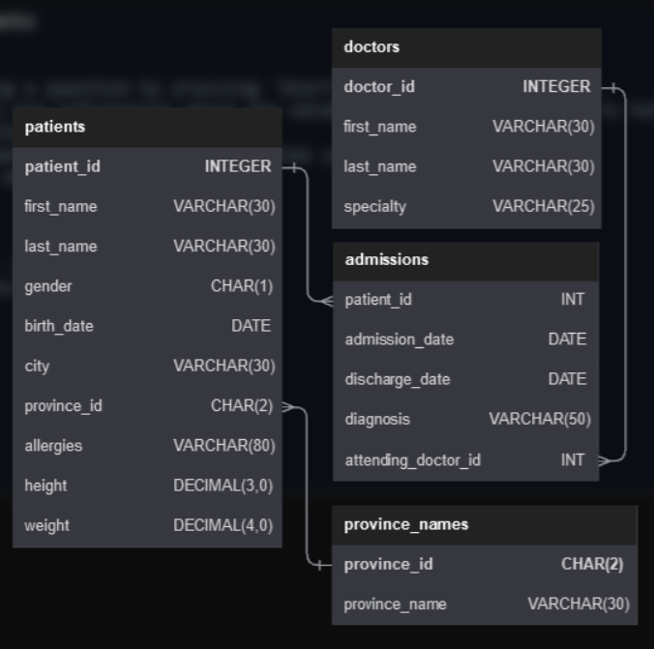
db.hospital
Four Tables (patients, doctors, admissions, province_names)
Primary keys:
patient_id (integer)
province_id (character)
doctor_id (integer)
Foreign keys:
patient_id (integer)
province_id (character)
attenting_doctor_id (integer)

Slide 5
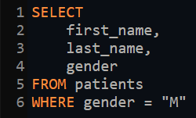
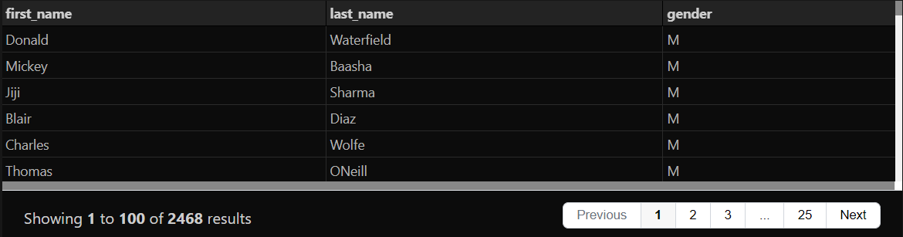
Easy
1. Show the first name, last name, and gender of patients whose gender is “M”.
Input:
Output:

Slide 6
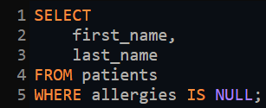
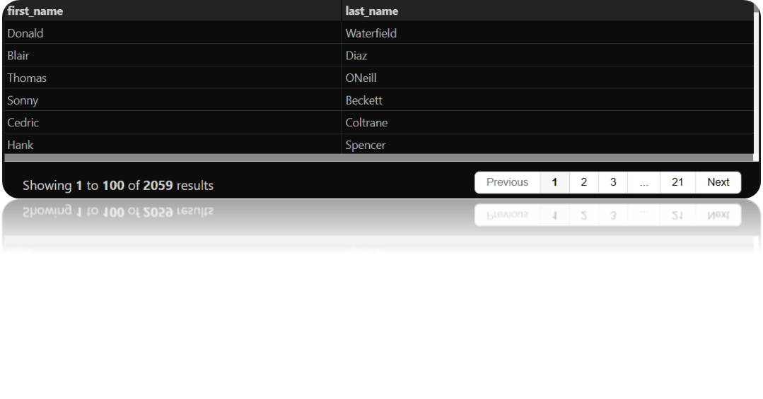
Easy
2. Show first name and last name of patients who does not have allergies (null).
Input:
Output:

Slide 7
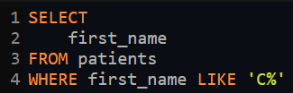

Easy
3. Show first name of patients that start with the letter 'C’.
Input:
Output:

Slide 8
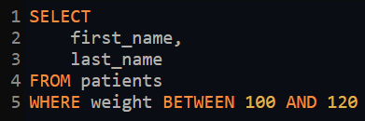
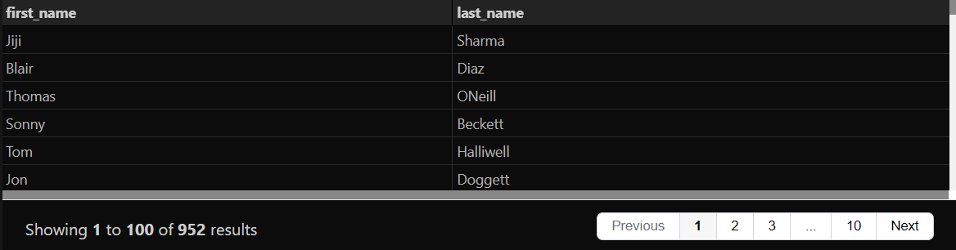
Easy
4. Show first name and last name of patients that weight within the range of 100 to 120 (inclusive).
Input:
Output:

Slide 9

Easy
5. Update the patients table for the allergies column. If the patient's allergies is null, then replace it with 'NKA’.
Input:
Output:

Slide 10

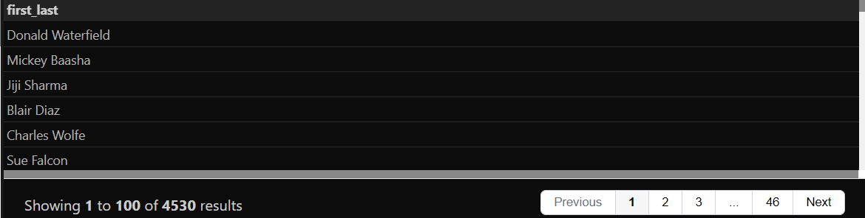
Easy
6. Show first name and last name concatenated into one column to show their full name.
Input:
Output:

Slide 11
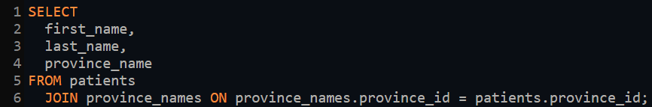
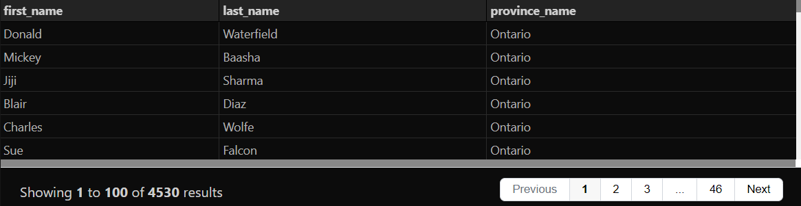
Easy
7. Show first name, last name, and the full province name of each patient.
Input:
Output:

Slide 12
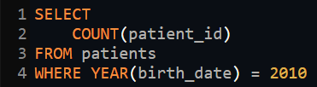
Easy
8. Show how many patients have a birth_date with 2010 as the birth year.
Input:
Output:

Slide 13
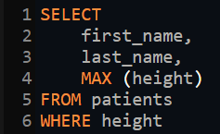
Easy
9. Show the first_name, last_name, and height of the patient with the greatest height.
Input:
Output:

Slide 14

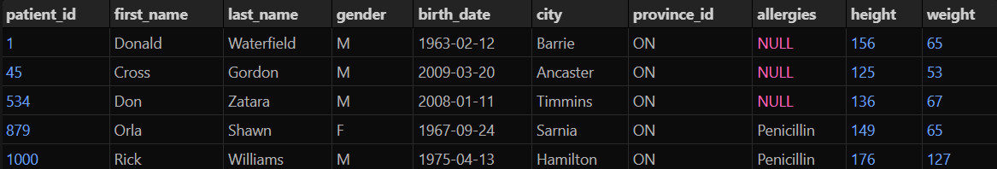
Easy
10. Show all columns for patients who have one of the following patient_ids:
1,45,534,879,1000.
Input:
Output:

Slide 15

Easy
11. Show the total number of admissions.
Input:
Output:

Slide 16

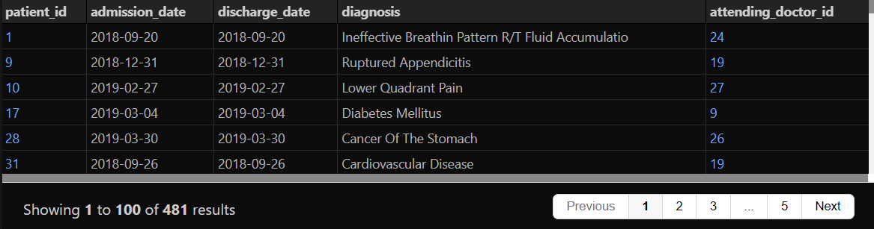
Easy
12. Show all the columns from admissions where the patient was admitted and discharged on the same day.
Input:
Output:

Slide 17
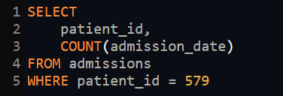
Easy
13. Show the patient id and the total number of admissions for patient_id 579.
Input:
Output:

Slide 18
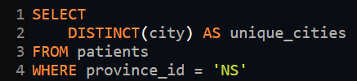

Easy
14. Based on the cities that our patients live in, show unique cities that are in province_id 'NS’.
Input:
Output:

Slide 19
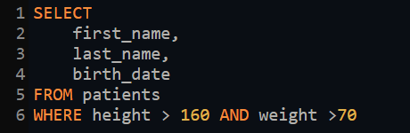
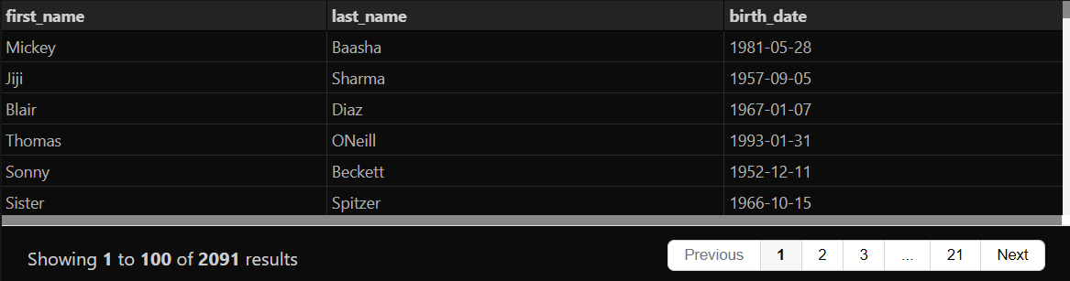
Easy
15. Write a query to find the first_name, last name and birth date of patients who has height greater than 160 and weight greater than 70.
Input:
Output:

Slide 20
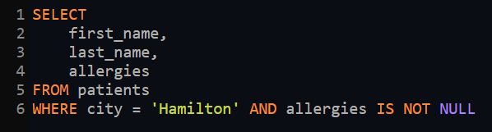
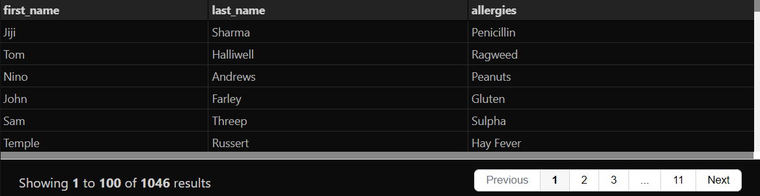
Easy
16. Write a query to find list of patients first_name, last_name, and allergies where allergies are not null and are from the city of 'Hamilton’.
Input:
Output:

Slide 21
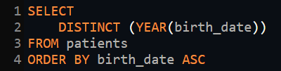

Medium
17. Show unique birth years from patients and order them by ascending.
Input:
Output:

Slide 22
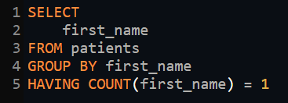
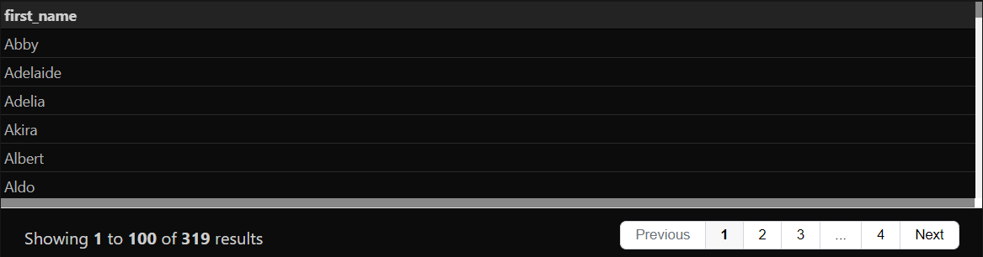
Medium
18. Show unique first names from the patients table which only occurs once in the list. For example, if two or more people are named 'John' in the first_name column then don't include their name in the output list. If only 1 person is named 'Leo' then include them in the output.
Input:
Output:

Slide 23
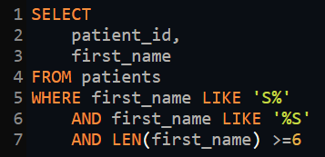
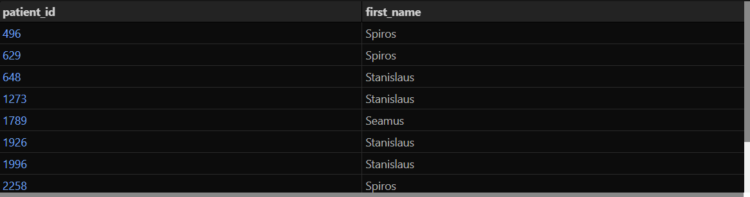
Medium
19. Show patient_id and first_name from patients where their first_name start and ends with 's' and is at least 6 characters long.
Input:
Output:

Slide 24
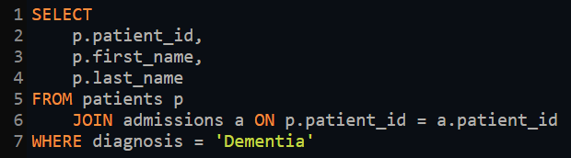
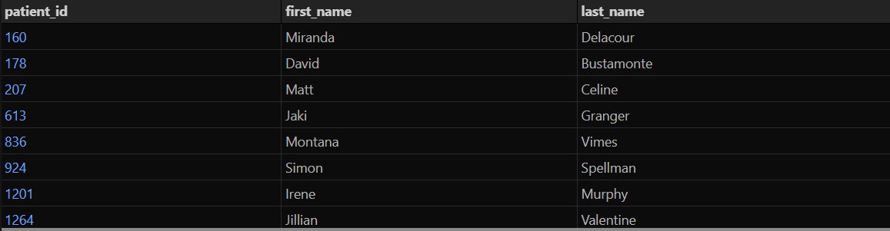
Medium
20. Show patient_id, first_name, last_name from patients whose diagnosis is 'Dementia’. Primary diagnosis is stored in the admissions table.
Input:
Output:

Slide 25
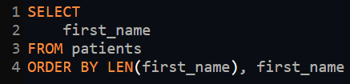
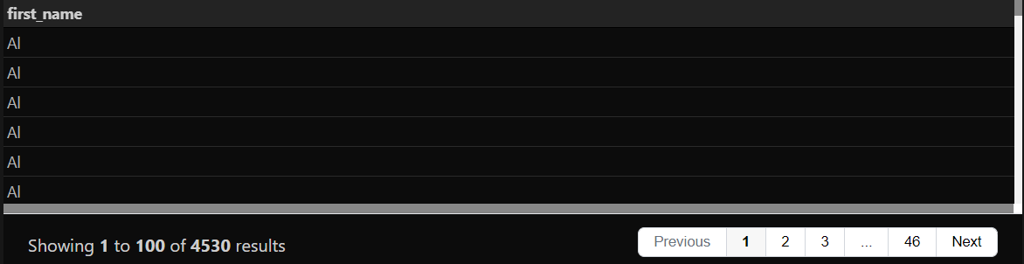
Medium
21. Display every patient's first_name. Order the list by the length of each name and then by alphabetically.
Input:
Output:

Slide 26

Medium
22. Show the total amount of male patients and the total amount of female patients in the patients table. Display the two results in the same row.
Input:
Output:

Slide 27
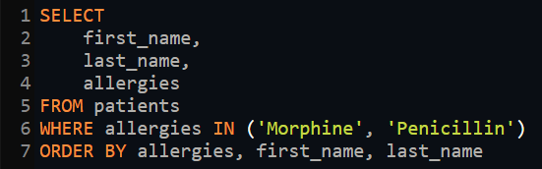
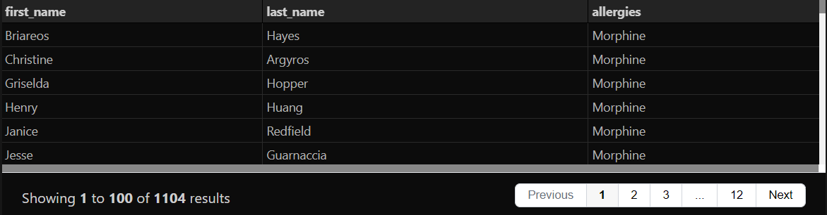
Medium
23. Show first and last name, allergies from patients which have allergies to either 'Penicillin' or 'Morphine'. Show results ordered ascending by allergies then by first_name then by last_name.
.
Input:
Output:

Slide 28
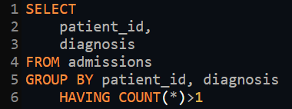
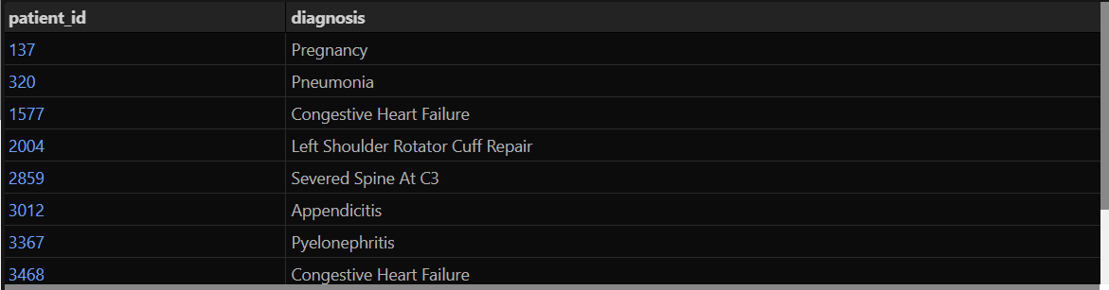
Medium
24. Show patient_id, diagnosis from admissions. Find patients admitted multiple times for the same diagnosis.
Input:
Output:

Slide 29
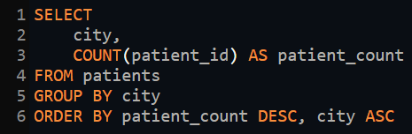
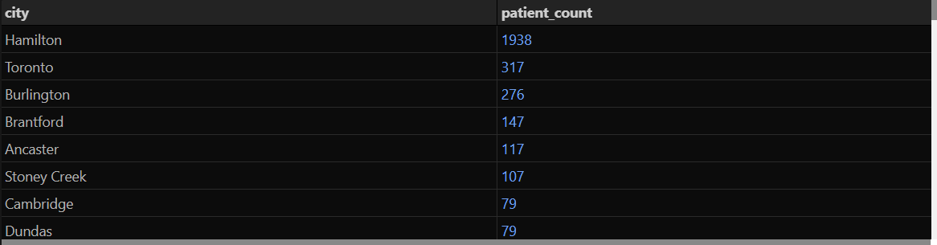
Medium
25. Show the city and the total number of patients in the city. Order from most to least patients and then by city name ascending
Input:
Output:

Slide 30

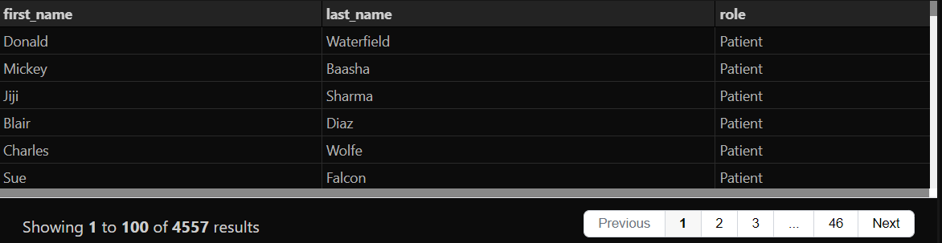
Medium
26. Show first name, last name and role of every person that is either patient or doctor. The roles are either "Patient" or "Doctor“.
Input:
Output:

Slide 31
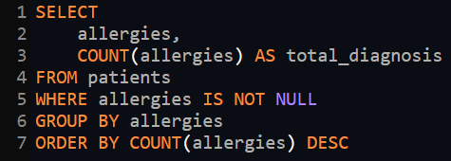
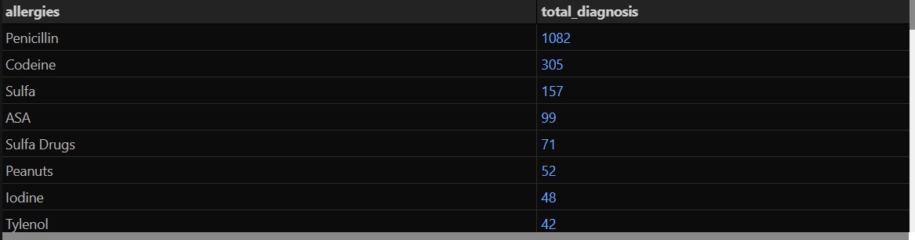
Medium
27. Show all allergies ordered by popularity. Remove NULL values from query.
Input:
Output:

Slide 32
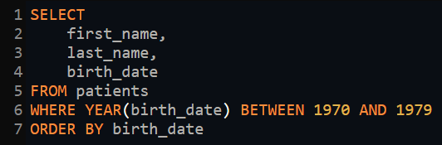
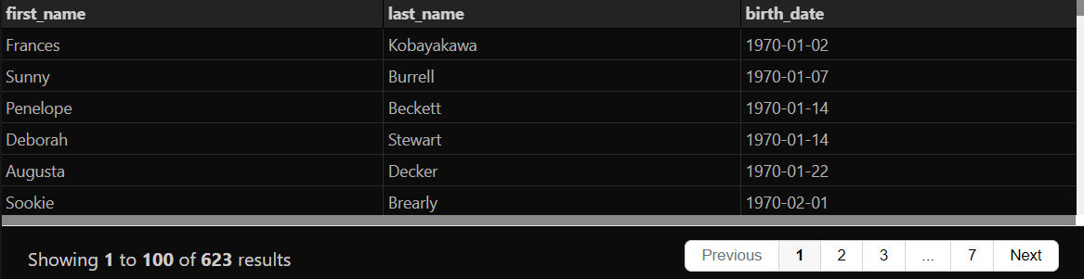
Medium
28. Show all patient's first_name, last_name, and birth_date who were born in the 1970s decade. Sort the list starting from the earliest birth_date.
Input:
Output:

Slide 33

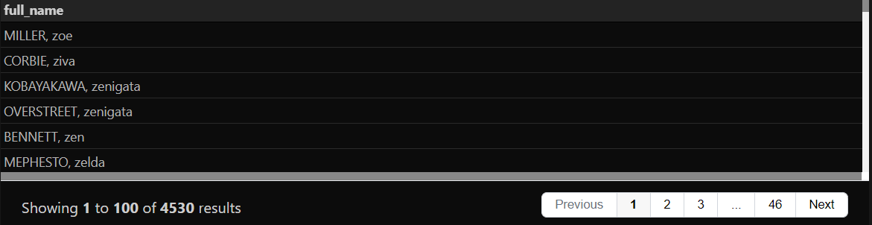
Medium
29. We want to display each patient's full name in a single column. Their last_name in all upper letters must appear first, then first_name in all lower case letters. Separate the last_name and first_name with a comma. Order the list by the first_name in decending order. EX: SMITH,jane.
Input:
Output:

Slide 34
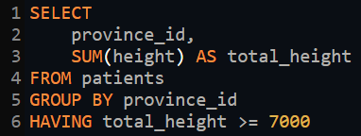
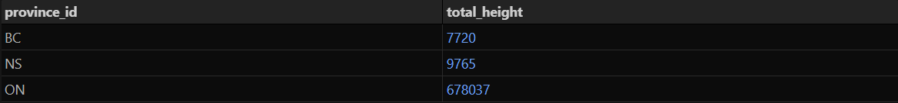
Medium
30. Show the province_id(s), sum of height; where the total sum of its patient's height is greater than or equal to 7,000.
Input:
Output:

Slide 35

Medium
31. Show the difference between the largest weight and smallest weight for patients with the last name 'Maroni’.
Input:
Output:

Slide 36
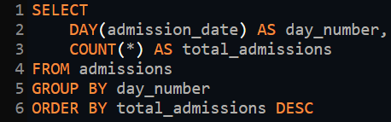

Medium
32. Show all of the days of the month (1-31) and how many admission_dates occurred on that day. Sort by the day with most admissions to least admissions.
Input:
Output:

Slide 37
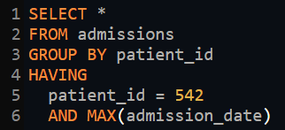
Medium
33. Show all columns for patient_id 542's most recent admission_date.
Input:
Output:

Slide 38
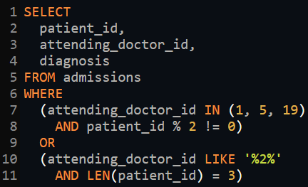
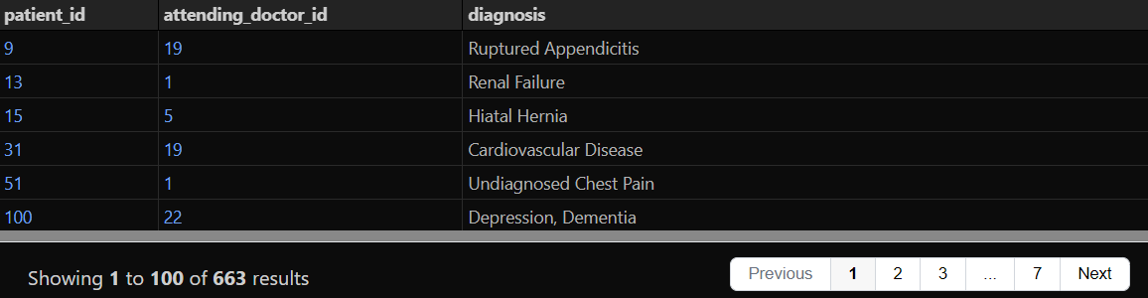
Medium
34. Show patient_id, attending_doctor_id, and diagnosis for admissions that match one of the two criteria:
1. patient_id is an odd number and attending_doctor_id is either 1, 5, or 19.
2. attending_doctor_id contains a 2 and the length of patient_id is 3 characters.
Input:
Output:

Slide 39
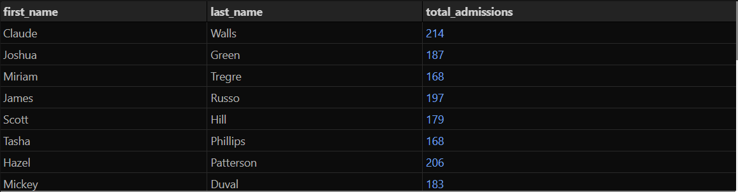
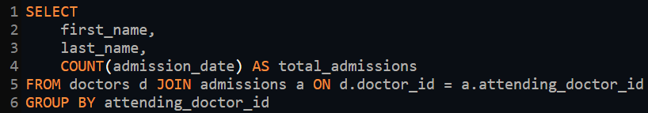
Medium
35. Show first_name, last_name, and the total number of admissions attended for each doctor. Every admission has been attended by a doctor.
Input:
Output:

Slide 40


Medium
36. For each doctor, display their id, full name, and the first and last admission date they attended.
Input:
Output:

Slide 41


Medium
37. Display the total amount of patients for each province. Order by descending.
Input:
Output:

Slide 42


Medium
38. For every admission, display the patient's full name, their admission diagnosis, and their doctor's full name who diagnosed their problem.
Input:
Output:

Slide 43


Medium
39. Display the first name, last name and number of duplicate patients based on their first name and last name. Ex: A patient with an identical name can be considered a duplicate.
Input:
Output:

Slide 44


Medium
40. Display patient's full name, height in the unit's feet rounded to 1 decimal, weight in the unit pounds rounded to 0 decimals, birth_date, gender non abbreviated. Convert CM to feet by dividing by 30.48. Convert KG to pounds by multiplying by 2.205.
Input:
Output:

Slide 45


Medium
41. Show patient_id, first_name, last_name from patients whose does not have any records in the admissions table. (Their patient_id does not exist in any admissions.patient_id rows.)
Input:
Output:

Slide 46


Hard
42. Show all of the patients grouped into weight groups. Show the total amount of patients in each weight group. Order the list by the weight group descending. For example, if they weight 100 to 109, they are placed in the 100-weight group, 110-119 = 110 weight group, etc.
Input:
Output:

Slide 47


Hard
43. Show patient_id, weight, height, isObese from the patients table. Display isObese as a boolean 0 or 1. Obese is defined as weight(kg)/(height(m)2) >= 30. Weight is in units kg, height is in units cm.
Input:
Output:

Slide 48

Hard
44. Show patient_id, first_name, last_name, and attending doctor's specialty. Show only the patients who has a diagnosis as 'Epilepsy' and the doctor's first name is 'Lisa'
Input:
Output:

Slide 49


Hard
45. All patients who have gone through admissions, can see their medical documents on our site. Those patients are given a temporary password after their first admission. Show the patient_id and temp_password. The password must be the following, in order:
1. patient_id
2. the numerical length of patient's last_name
3. year of patient's birth_date
Input:
Output:

Slide 50

Hard
46. Each admission costs $50 for patients without insurance, and $10 for patients with insurance. All patients with an even patient_id have insurance. Give each patient a 'Yes' if they have insurance, and a 'No' if they don't have insurance. Add up the admission_total cost for each has_insurance group.
Input:
Output:

Slide 51


Hard
47. Show the provinces that has more patients identified as 'M' than 'F'. Must only show full province_name.
Input:
Output:

Slide 52


Hard
48. Sort the province names in ascending order in such a way that the province 'Ontario' is always on top.
Input:
Output:

Slide 53

Hard
49. We are looking for a specific patient. Pull all columns for the patient who matches the following criteria. First_name contains an 'r' after the first two letters. Identifies their gender as ‘F’. Born in February, May, or December. Their weight would be between 60kg and 80kg. Their patient_id is an odd number. They are from the city 'Kingston'
Input:
Output:

Slide 54


Hard
50. Show the percent of patients that have 'M' as their gender. Round the answer to the nearest hundreth number and in percent form.
Input:
Output:

Slide 55


Hard
51. For each day display the total amount of admissions on that day. Display the amount changed from the previous date.
Input:
Output:

Slide 56


Hard
52. We need a breakdown for the total amount of admissions each doctor has started each year. Show the doctor_id, doctor_full_name, specialty, year, total_admissions for that year.
Input:
Output:

Slide 57
Command Glossary
1. CASE: Conditional logic in SQL queries.
2. DISTINCT: Retrieve unique values from specified columns.
3. GROUP BY: Group rows based on common values in specified columns.
4. HAVING: Filter results based on aggregate conditions.
5. IN: Filter results based on a list of specified values.
6. JOIN: Combine rows from two or more tables based on related columns.
7. LIKE: Search for a specified pattern in a column.
8. NULL: Represents the absence of data in a column.
9. UNION: Combine result sets of two or more `SELECT` statements.
10. WHERE: Filter rows based on specified conditions.
11. COUNT: Count the number of rows or occurrences of a value.
12. AVG: Calculate the average value of a numeric column.
13. SUM: Calculate the sum of values in a numeric column.
14. MAX: Return the maximum value in a column.
15. MIN: Return the minimum value in a column.

